Slide 1
Module – 4
Chapter – 10
Artificial Neural Network

Slide 2
10.1 INTRODUCTION
The human nervous system has billions of neurons that are the processing units which make humans to perceive things, to hear, to see and to smell.
The human nervous system works beautifully, making us understand who we are, what we do, where we are and everything in our surrounding.
It makes us to remember, recognize and correlate things around us.
It is a learning system that consists of functional units called nerve cells, typically called as neurons.
The human nervous system is divided into two sections called the Central Nervous System (CNS) and the Peripheral Nervous System (PNS).

Slide 3
The brain and the spinal cord constitute the CNS and the neurons inside and outside the CNS constitute the PNS.
The neurons are basically classified into three types called sensory neurons, motor neurons and interneurons.
Sensory neurons get information from different parts of the body and bring it into the CNS, whereas motor neurons receive information from other neurons and transmit commands to the body parts.
The CNS consists of only interneurons which connect one neuron to another neuron by receiving information from one neuron and transmitting it to another.
The basic functionality of a neuron is to receive information, process it and then transmit it to another neuron or to a body part.

Slide 4
10.2 BIOLOGICAL NEURONS
A typical biological neuron has four parts called dendrites, soma, axon and synapse. The body of the neuron is called as soma.
Dendrites accept the input information and process it in the cell body called soma.
A single neuron is connected by axons to around 10,000 neurons and through these axons the processed information is passed from one neuron to another neuron.
A neuron gets fired if the input information crosses a threshold value and transmits signals to another neuron through a synapse. A synapse gets fired with an electrical impulse called spikes which are transmitted to another neuron.

Slide 5
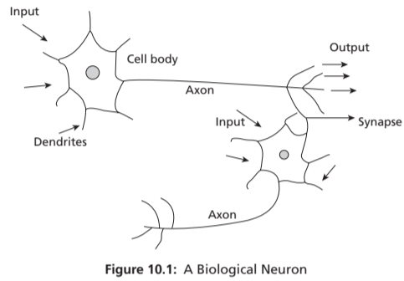
A single neuron can receive synaptic inputs from one neuron or multiple neurons. These neurons form a network structure which processes input information and gives out a response.

Slide 6
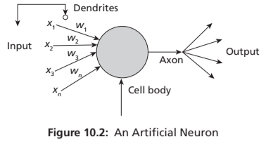
10.3 ARTIFICIAL NEURONS
Artificial neurons are like biological neurons which are called as nodes. A node or a neuron can receive one or more input information and process it. Artificial neurons or nodes are connected by connection links to one another. Each connection link is associated with a synaptic weight. The structure of a single neuron is shown in Figure 10.2.

Slide 7
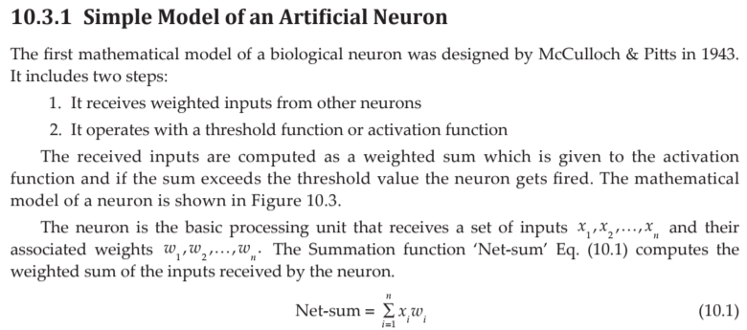
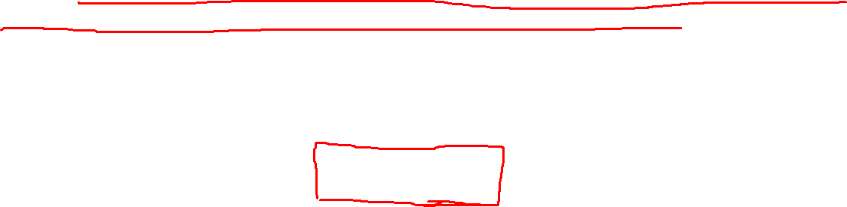

Slide 8
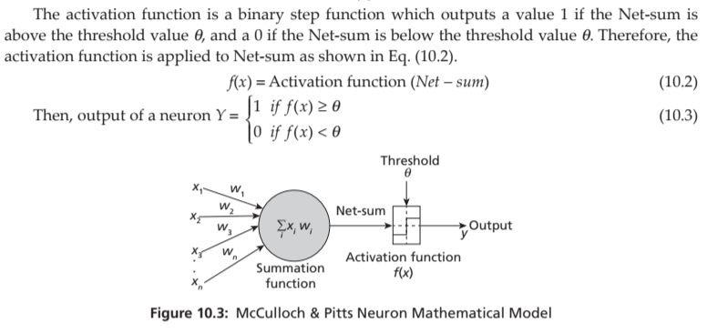
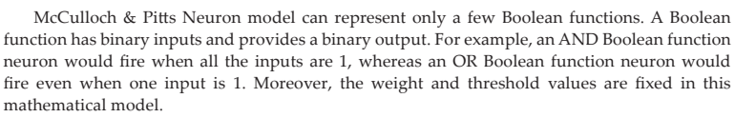


Slide 9
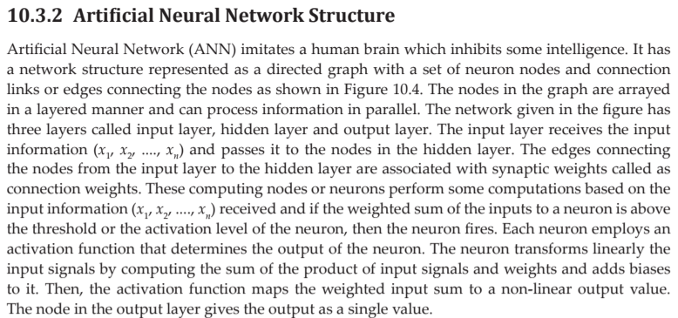
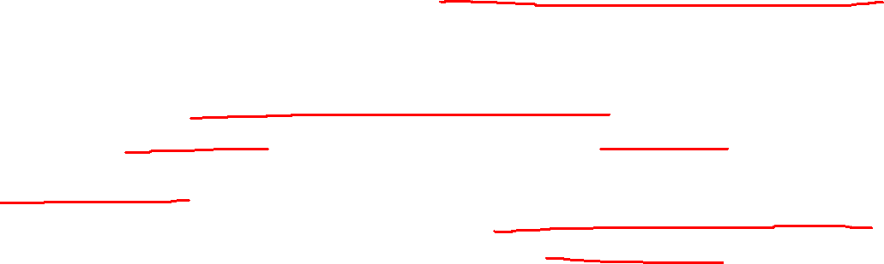

Slide 10
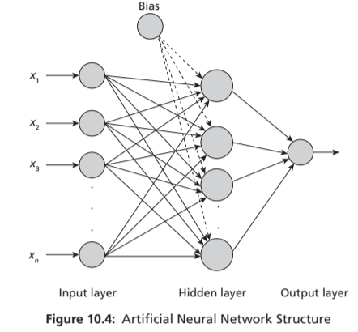

Slide 11
10.3.3 Activation Functions
Activation functions are mathematical functions associated with each neuron in the neural network that map input signals to output signals. (used to introduce non-linearity)
It decides whether to fire a neuron or not based on the input signals the neuron receives.
These functions normalize the output value of each neuron either between 0 and 1 or between -1 and +1.
Typical activation functions can be linear or non-linear.
Linear functions are useful when the input values can be classified into any one of the two groups and are generally used in binary perceptrons.
Non-linear functions, on the other hand, are continuous functions that map the input in the range of (0, 1) or (-1, 1), etc.
These functions are useful in learning high-dimensional data or complex data such as audio, video and images.

Slide 12
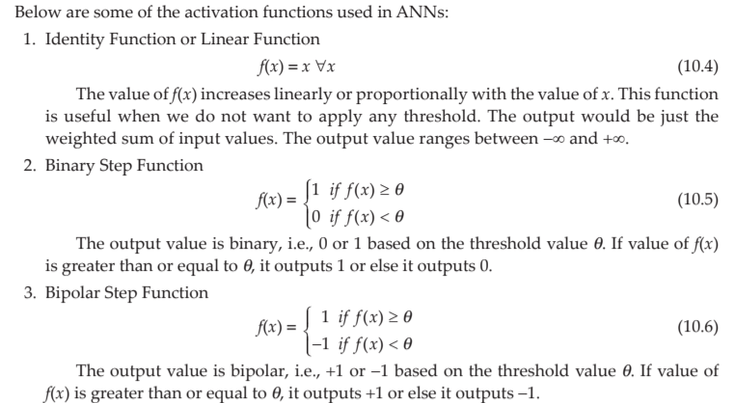


Slide 13
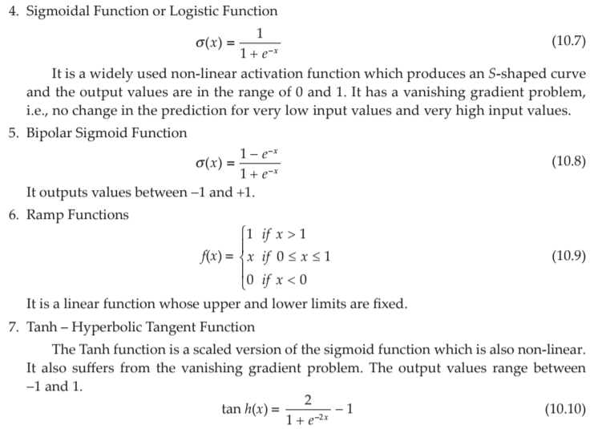


Slide 14
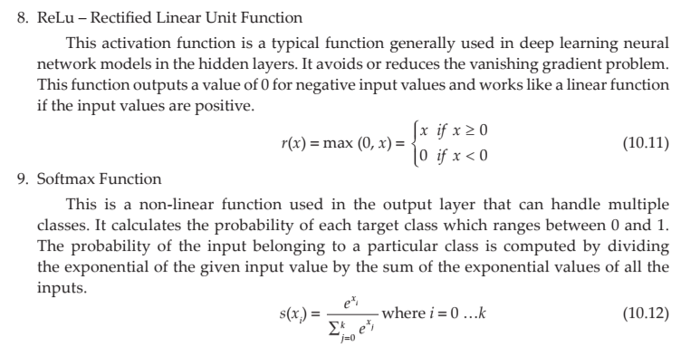

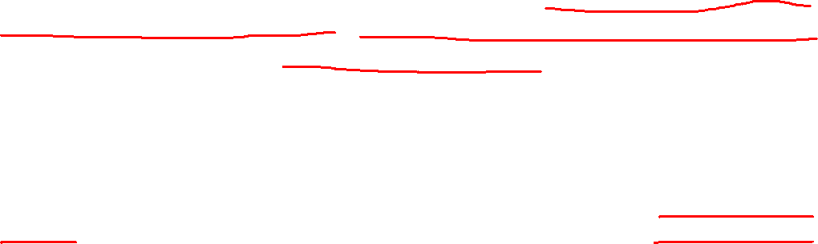

Slide 15
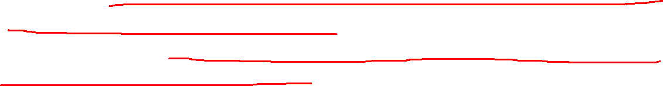
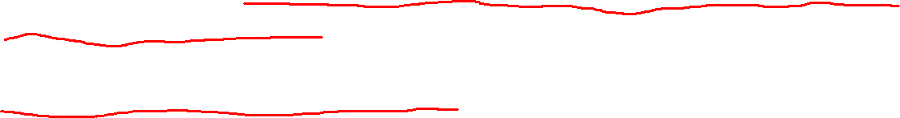

10.4 PERCEPTRON AND LEARNING THEORY
The first neural network model ‘Perceptron’, designed by Frank Rosenblatt in 1958, is a linear binary classifier used for supervised learning.
He modified the McCulloch & Pitts Neuron model by combining two concepts, McCulloch-Pitts model of an artificial neuron and Hebbian learning rule of adjusting weights.
He introduced variable weight values and an extra input that represents bias to this model.
He proposed that artificial neurons could actually learn weights and thresholds from data and came up with a supervised learning algorithm that enabled the artificial neurons to learn the correct weights from training data by itself.

Slide 16
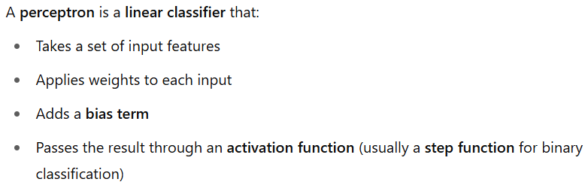
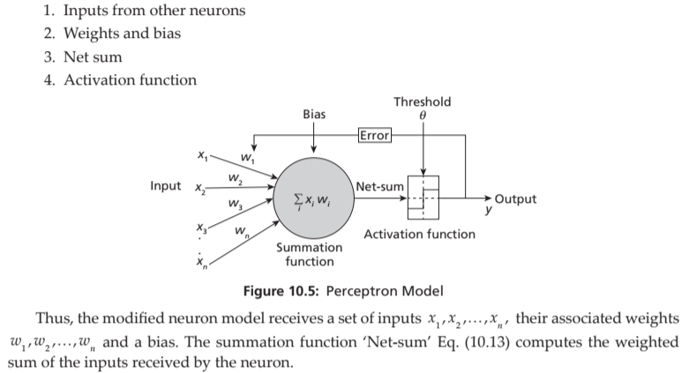
The perceptron model (shown in Figure 10.5) consists of 4 steps:

Slide 17
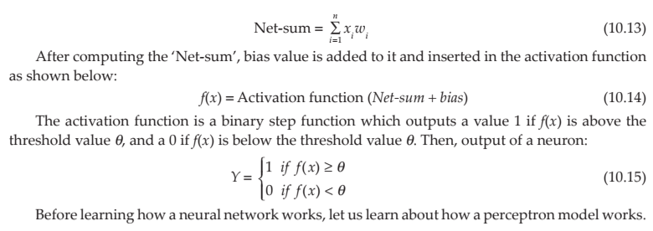

Slide 18
Understanding
In neural networks, "bias" refers to a constant value added to the output of a neuron before it's passed through the activation function.
It acts as a threshold or offset, allowing neurons to activate even when the weighted sum of inputs is not sufficient
Learning rate is a hyperparameter that governs how much a machine learning model adjusts its parameters at each step of its optimization algorithm

Slide 19
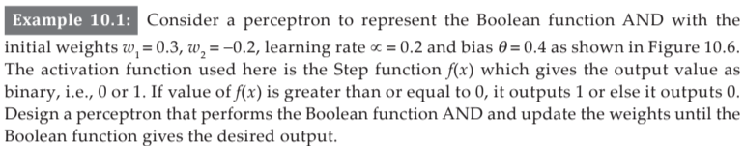
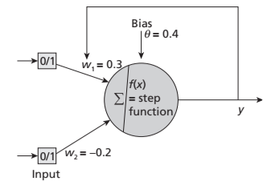
Activation func :A mathematical function applied to a neuron's output to introduce non-linearity into the model.
Step func: A binary activation function that outputs either 0 or 1 based on whether the input is above or below a threshold.

Slide 20
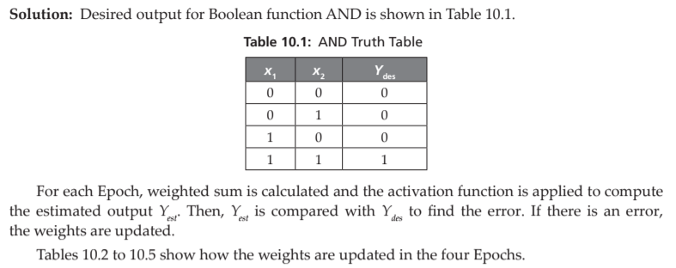

Slide 21
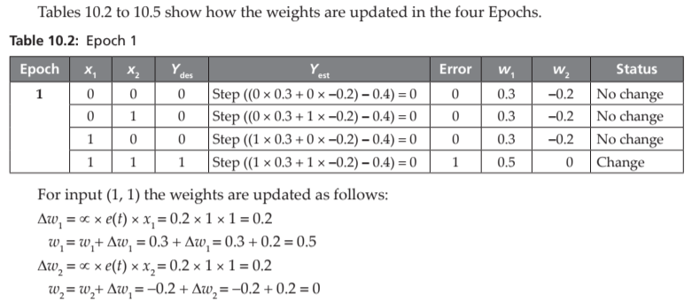

The table implements that threshold by subtracting 0.4 in the net input

Slide 23
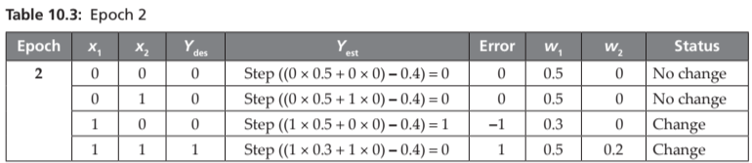
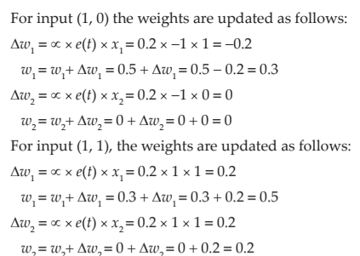

Slide 24
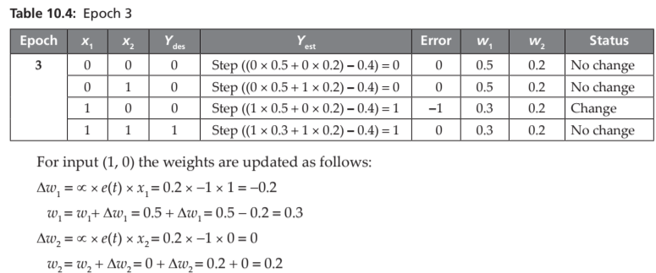

Slide 25
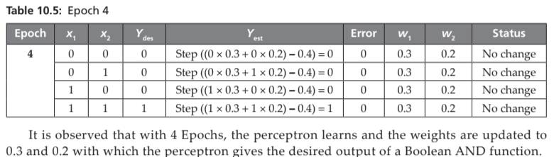

Slide 26
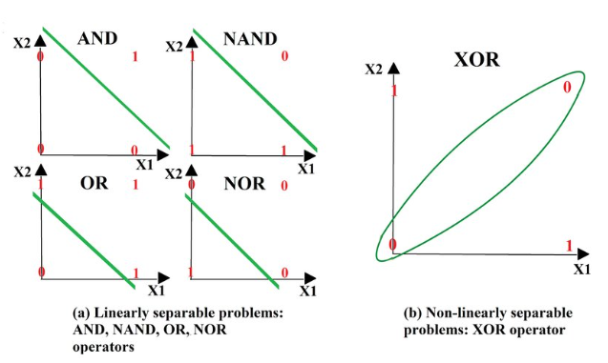
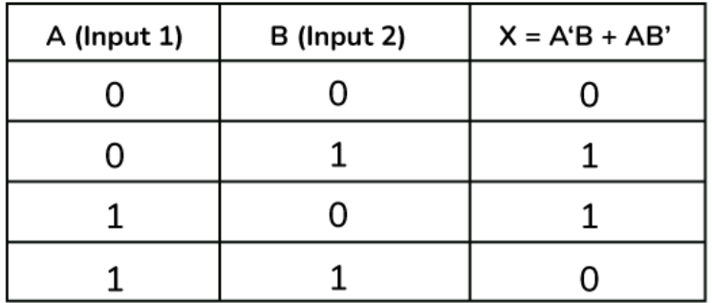
For Understanding : Linearly separable and Non-Linearly separable
XOR

Slide 27
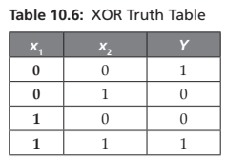
10.4.1 XOR Problem
A perceptron model can solve all Boolean functions which are linearly separable. However, the XOR problem was identified in 1969 by Minsky and Papert.
An XOR function returns a 1, if the two inputs are not equal and a 0 if they are equal. Following is the truth table of an XOR function shown in Table 10.6.

Slide 28
Since XOR is not linearly separable, the single layer perceptron failed to classify and hence this problem led to the evolution of a multi-layer perceptron.
Initially, the Multi-Layer Perceptron (MLP) was not a success due to the lack of an appropriate learning algorithm.
In 1974, Werbos introduced a back propagation algorithm for the three-layered perceptron network and in 1986, a general back propagation algorithm for a multi-layered perceptron was introduced by Rummelhart and Mclelland.
Then, again ANN and Deep Neural Networks became a success, solving many complex problems in the current era.

Slide 29
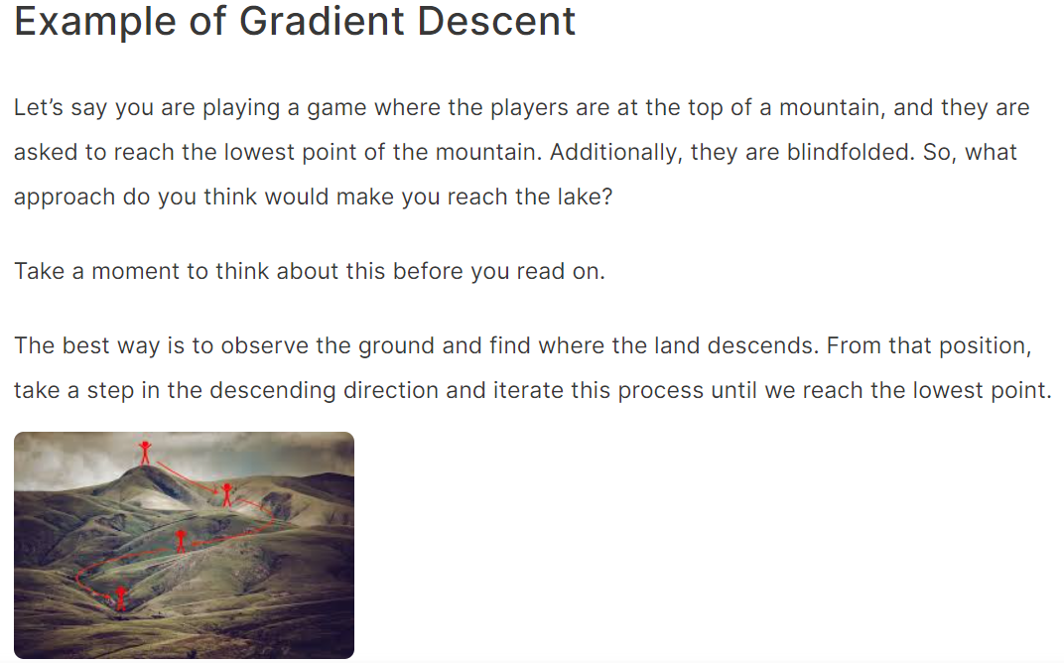
Gradient descent is an iterative optimization algorithm for finding the local minimum of a function.

Slide 30
10.4.2 Delta Learning Rule and Gradient Descent
Generally, Learning in neural networks is performed by adjusting the network weights in order to minimize the difference between the desired and estimated outputs.
This delta difference is measured as an error function or also called as cost function. The cost function, being linear and continuous, is differentiable.
This way of learning called as delta rule (also known as Widrow-Hoff” rule or Adaline rule) is a type of back propagation applied for training the network.
Gradient Descent is an optimization algorithm used to minimize a loss (or cost) function in machine learning and deep learning models.

Slide 31
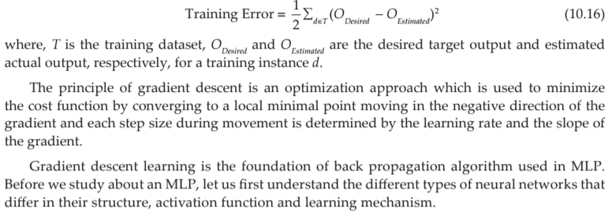
The training error of a hypothesis is half the squared difference between the desired target output and actual output and is given as follows:

Slide 32
10.5 TYPES OF ARTIFICIAL NEURAL NETWORKS
ANNs consist of multiple neurons arranged in layers.
There are different types of ANNs that differ by the network structure, activation function involved and the learning rules used.
In an ANN, there are three layers called input layer, hidden layer and output layer.
Any general ANN would consist of one input layer, one output layer and zero or more hidden layers.

Slide 33
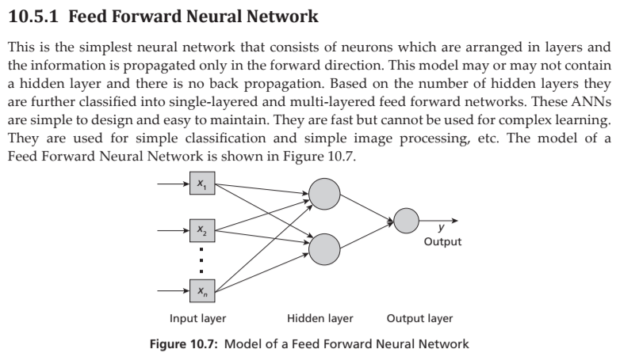

Slide 34
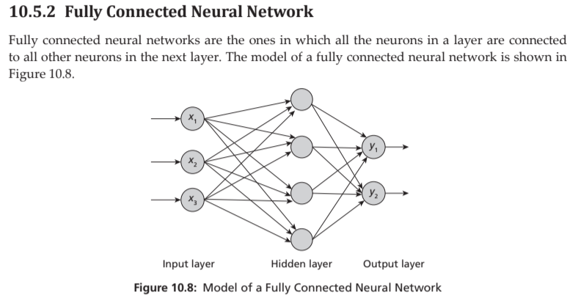

Slide 35
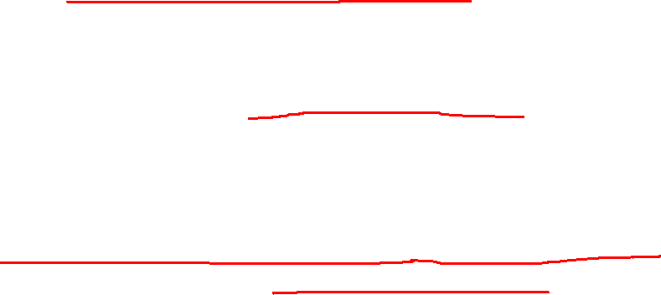
10.5.3 Multi-Layer Perceptron (MLP)
This ANN consists of multiple layers with one input layer, one output layer and one or more hidden layers. Every neuron in a layer is connected to all neurons in the next layer and thus they are fully connected.
The information flows in both the directions. In the forward direction, the inputs are multiplied by weights of neurons and forwarded to the activation function of the neuron and output is passed to the next layer.
If the output is incorrect, then in the backward direction, error is back propagated to adjust the weights and biases to get correct output. Thus, the network learns with the training data.

Slide 36
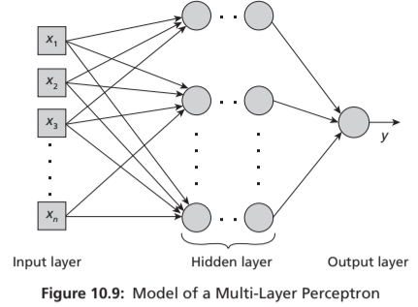
This type of ANN is used in deep learning for complex classification, speech recognition, medical diagnosis, forecasting, etc. They are comparatively complex and slow. The model of an MLP is shown in Figure.

Slide 37
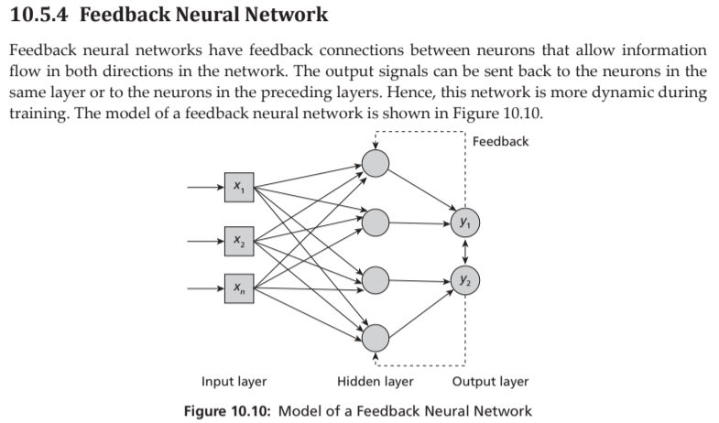

Slide 38
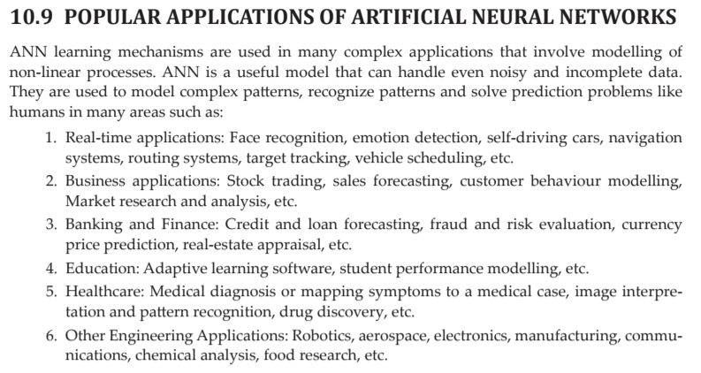

Slide 39
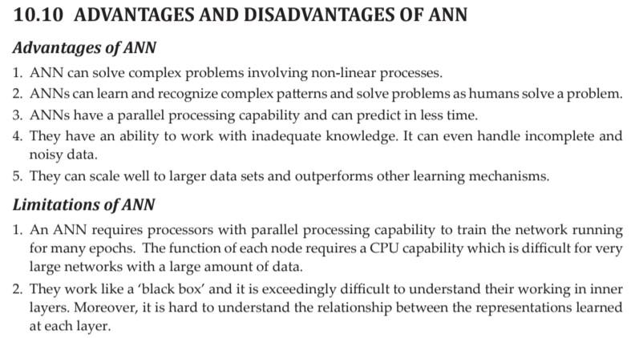

Slide 40
